Slide 1
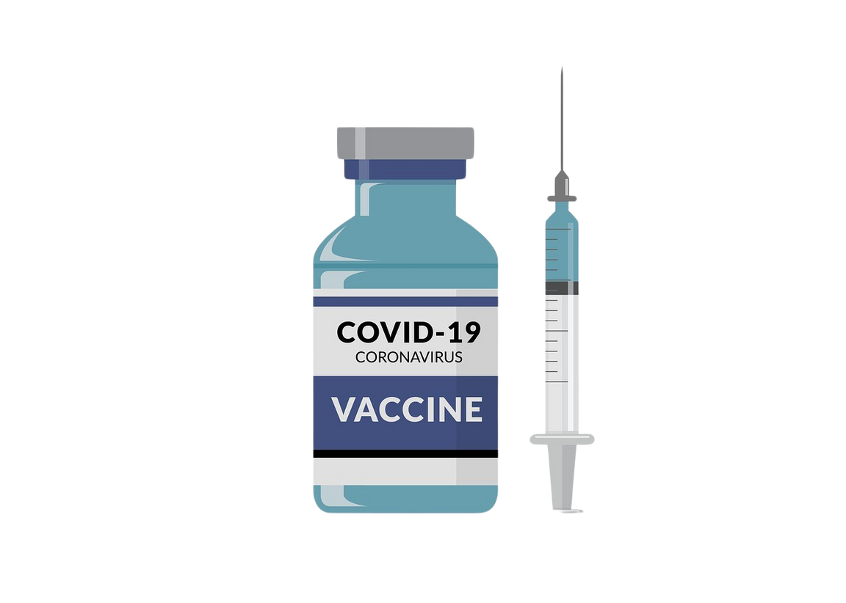
Page 01
Healthcare
COVID-19 IN INDIA
Exploring the Impact and Trends
--TANISHQ MAHAJAN

Slide 2

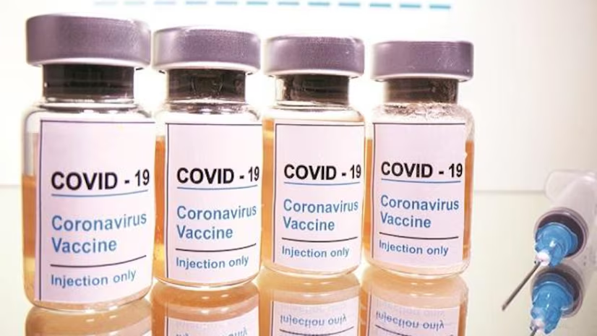




COVID-19 Data Analysis
Page 02
INTRODUCTION
Exploring COVID-19 Statistics in India
Time Period Covered
Overview of Covid-19 Impact
Highlighting the duration for January 1, 2020, to September 1, 2021., offering insights into the progression of COVID-19
Analyzing the spread and effects of COVID-19 across India, including key metrics such as total cases, recoveries, and fatalities.
Data Sources
Purpose of the Analysis
Detailing the credible sources used to gather COVID-19 statistics in India, ensuring accuracy and reliability in the information presented.
Understanding the objective of the dashboard, which aims to provide real-time and comprehensive data insights into the COVID-19 situation in India.

Slide 3
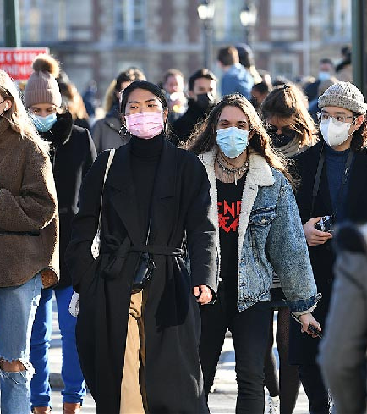
Table Of Content
Page 03
Problem Statement
Total Deaths by State
Age Group Details
Covid Cases by State
ICMR Testing Labs in each State
Gender Wise Distribution
State Wise Testing Details
Doses Administered by Vaccine
First vs Second Dose Administered
Solutions & Recommendations

Slide 4

Problem Statement
1.Significant Impact of COVID-19 in India:
Reveals critical gaps in healthcare system.
Highlights inadequacies in pandemic response strategies.
2. Comprehensive Data Analysis:
Analyzes infection rates, mortality, testing capacity, and vaccination progress.
Provides state-wise metrics for detailed insights.
3. Geographical Disparities and Demographic Vulnerabilities:
Identifies differences in COVID-19 impact across states.
Highlights age groups and populations most affected.
4. Testing Infrastructure and Vaccination Coverage:
Examines distribution and capacity of testing labs.
Analyzes vaccination progress and coverage by state.
5. Targeted Interventions and Policy Recommendations:
Identifies areas for improvement in healthcare infrastructure.
Develops strategies to enhance pandemic preparedness and response.
6. Future Public Health Strategies:
Provides insights for shaping resilient healthcare systems.
Ensures effective management of future pandemics.

Slide 5
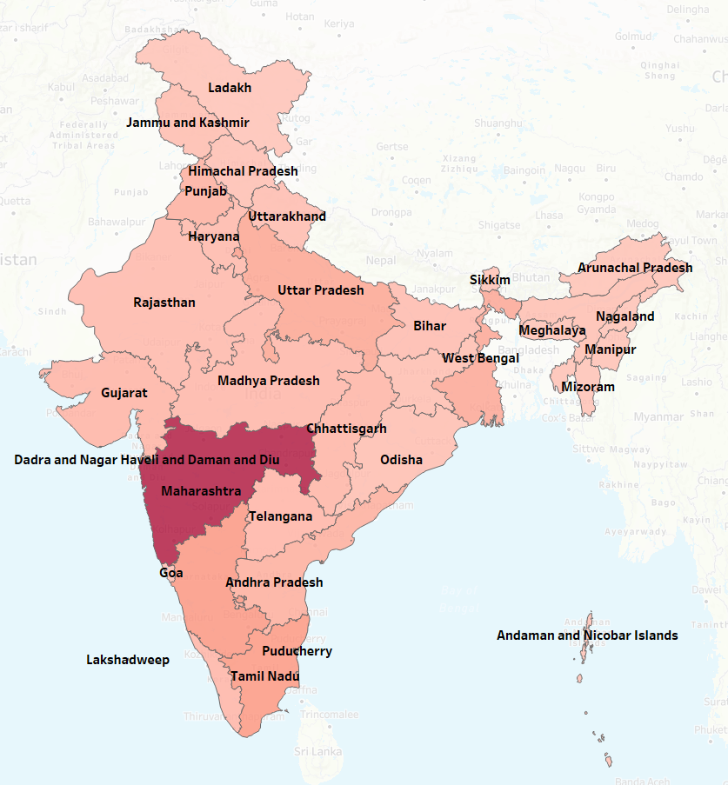
Total Deaths by State
The graph shows death distribution across Indian states.
Highest deaths in Maharashtra and Tamil Nadu.
Data highlights regional impact of COVID-19.
Key for understanding state-specific mortality rates.

Slide 6
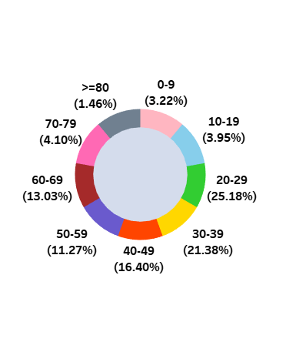
Age Group Details
This graph displays COVID-19 cases by age group.
Highest cases in 20-29 age group.
Significant cases in ages 30-39 and 40-49.
Insights on age-related vulnerability patterns.

Slide 7
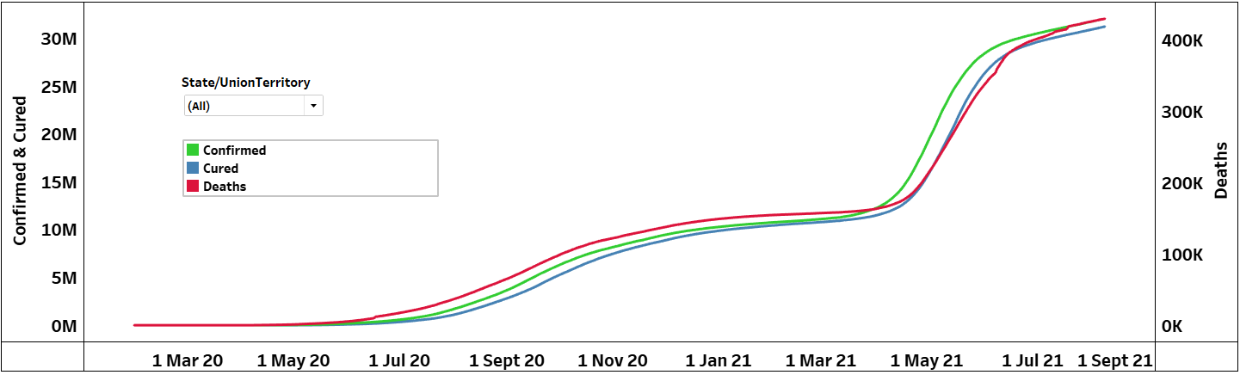
Covid Cases by State
The Graph shows the trend of confirmed, cured, and death cases as per each state.
Shows data from January 2020 to September 2021.
It is a visual comparison of case trends by state.
Highlights peak periods of COVID-19 spread and also shows the number of confirmed, cured and death rates.

Slide 8
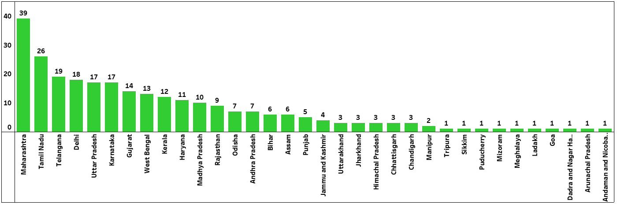
ICMR Testing Labs in each State
The graph represents distribution of testing facilities.
Maharashtra leads with 39 testing labs.
Significant lab numbers in Telangana and Tamil Nadu.
Highlights states with fewer testing labs.

Slide 9
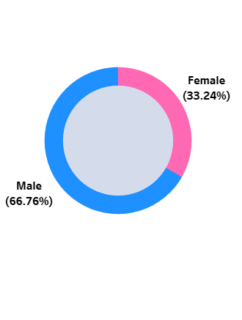
Page 08
Gender Wise Distribution
The visual representation with pie chart shows the gender distribution.
Male cases represent 66.76% of total.
Female cases account for 33.24% overall.
Significant gender disparity in COVID-19 cases.

Slide 10
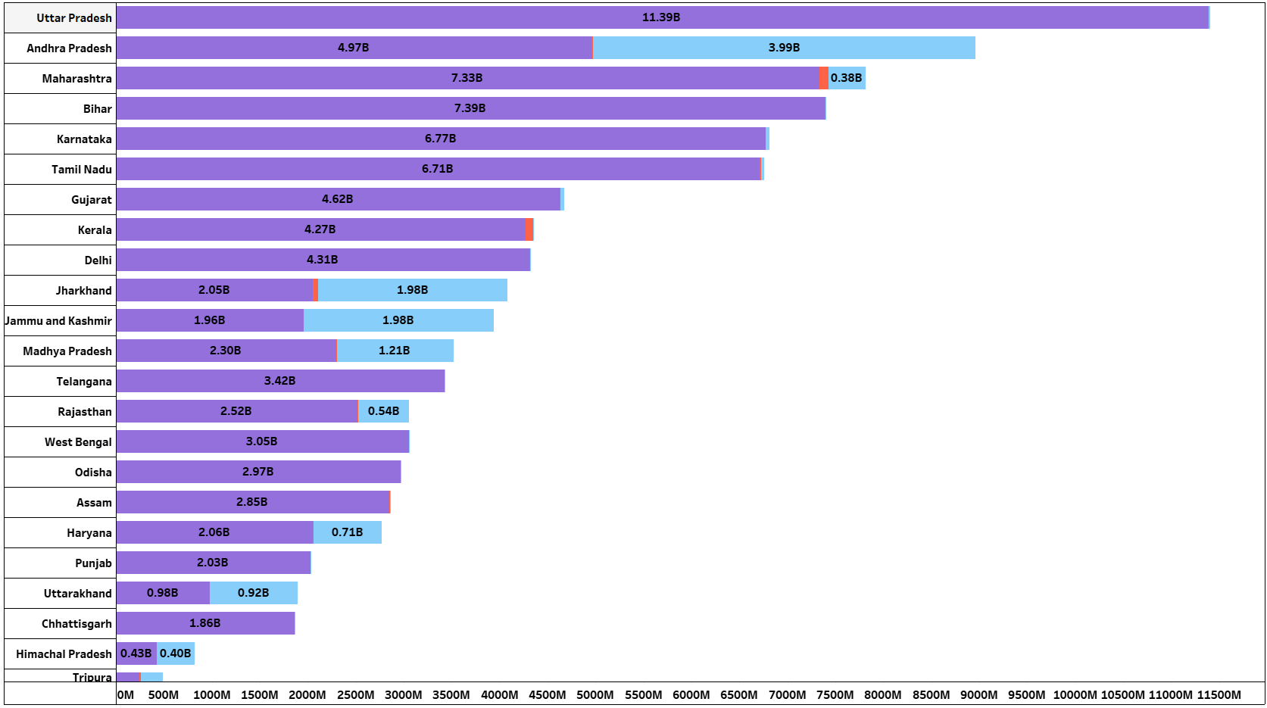
STATE WISE TESTING DETAILS
The Bar graph highlights testing distribution.
Uttar Pradesh leads with 11.4B tests, 2.74M Positive tests & 16.23M Negative tests.
Andhra Pradesh follows with 4.97B, 3.86M Positive tests & 3.99B Negative tests.
Significant testing efforts in top states.

Slide 11
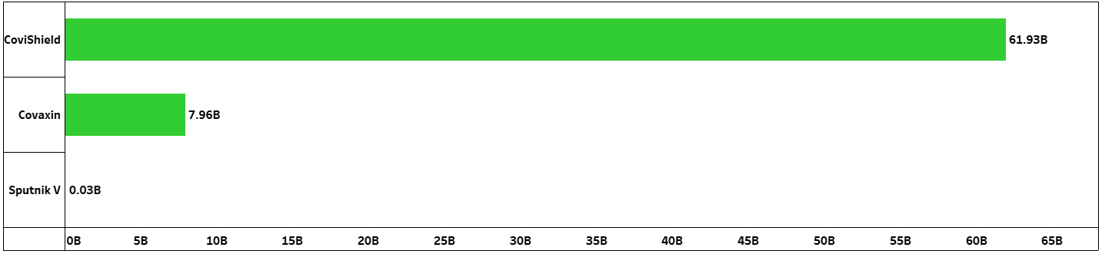
Doses Administered by Vaccine
The Bar graph shows type of vaccine distribution.
CoviShield leads with 61.9M doses.
Covaxin follows with 7.96M doses.
Sputnik V administered 28.9K doses.

Slide 12
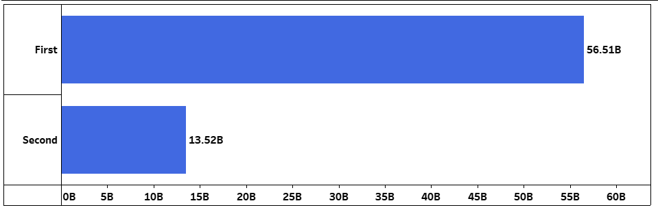
First vs Second Dose Administered
The Bar graph illustrates dosage distribution.
First dose: 56.5B doses administered.
Second dose: 13.5B doses administered.
Significant gap between first and second doses.

Slide 13
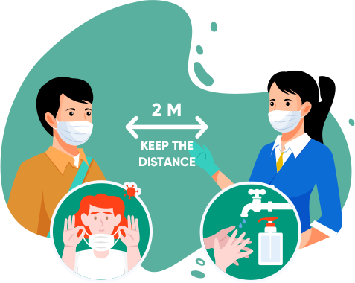
Proposed Solutions & Recommendations
1. Enhance Healthcare Infrastructure:
Increase the number of testing labs and healthcare facilities.
Improve availability of medical supplies and PPE.
2. Strengthen Vaccination Campaigns:
Ensure widespread availability of vaccines.
Prioritize full vaccination coverage with both doses.
3. Implement Targeted Public Health Interventions:
Focus on high-risk age groups and vulnerable populations.
Develop state-specific strategies based on local data.
4. Improve Data Collection and Analysis:
Invest in robust data collection systems.
Use real-time data for decision-making and resource allocation.
5. Increase Public Awareness and Education:
Conduct information campaigns about preventive measures.
Promote vaccination and adherence to health guidelines.
6. Foster Collaborative Efforts:
Encourage partnerships between government, private sector, and NGOs.
Engage community leaders in public health initiatives.

Slide 14

Thank You

